Slide 1
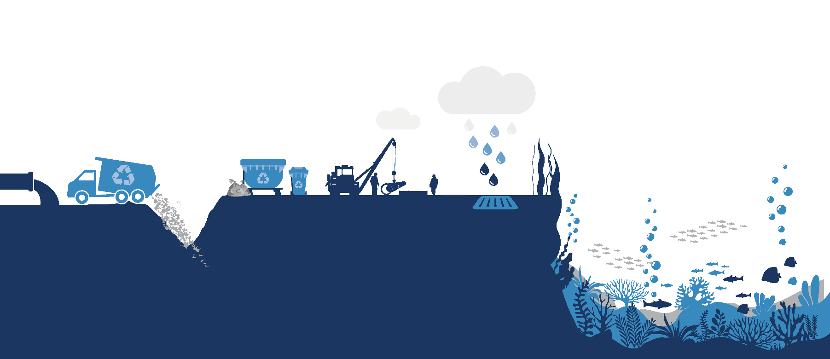
Clean Oceans Project Identification and Preparation (COPIP) for Sub Saharan Africa
Introduction presentation
1 of 10
Notes:
We have a few slides which explain the process.

Slide 2
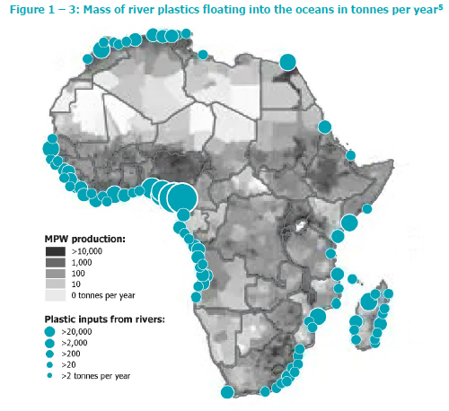
The Problem
Mass of river plastics floating into the oceans in tonnes per year
Notes:
The diagram shows the amount of Mis-managed Plastic Waste (MPW) generated in Sub Saharan Africa. The grey shades shows the waste of the countries and the estimated plastic debris from the rivers to the oceans is shown in blue circles. The coastline from Senegal to Angola is the largest source of debris. WB 2016 report 170 Million tonnes of waste was produced in Sub Saharan Africa in 2016

Slide 3
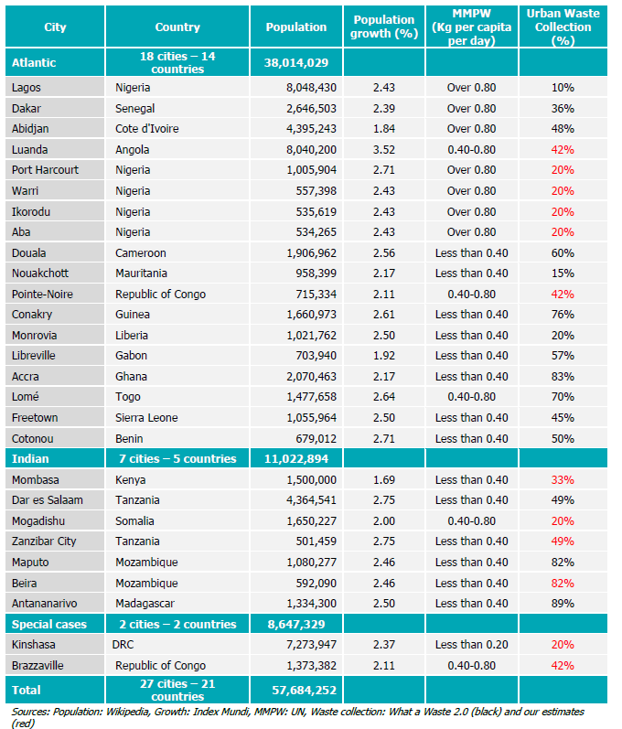
The Problem
Largest coastal cities in
Sub-Saharan Africa
(less than 50km from the sea)
Notes:
The table shows the largest coastal cities in Sub Saharan Africa. From the coast towns in Mauritania to Angola, Luanda which includes the entire gulf of Guinea 18 of the 30 large coastal sites are concentrated there, with an urban population of 38 million.

Slide 4
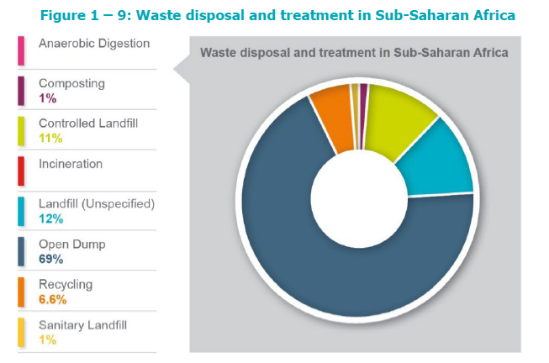
The Problem
Waste disposal and treatment in Sub-Saharan Africa
Notes:
The diagram shows what is done with the waste, which is almost nothing with nearly 70% is openly dumped

Slide 5
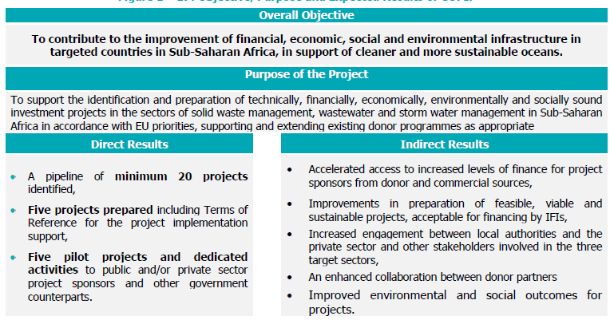
What we will do
Notes:
The Clean Oceans Project Identification Project (COPIP) has been developed as shown above, with a focus on providing infrastructure and solid waste management as the priority but includes wastewater and storm water management.

Slide 6
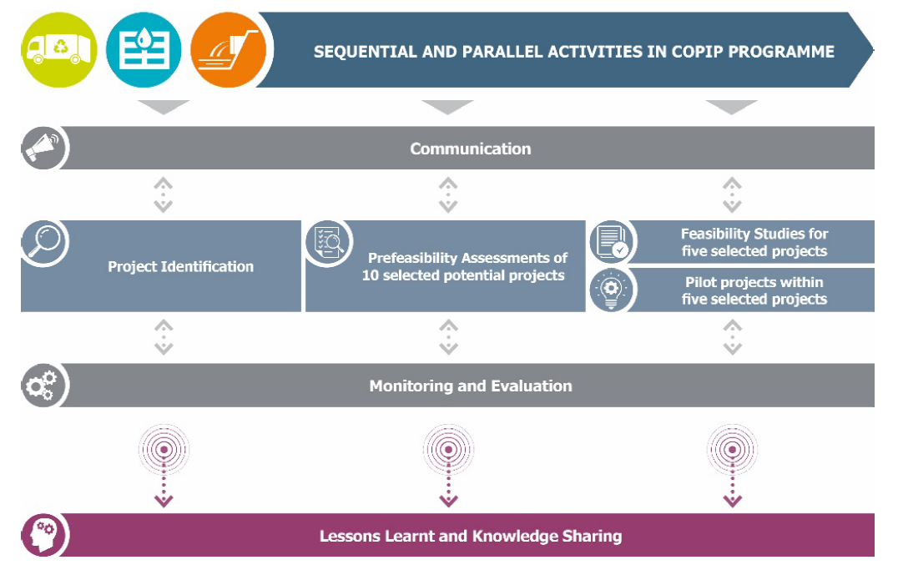
What we will do
Notes:
Showing the interrelationship with the cross-cutting activities. Comms, monitoring and lesson learning. Important to flag the lesson learning and knowledge sharing

Slide 7
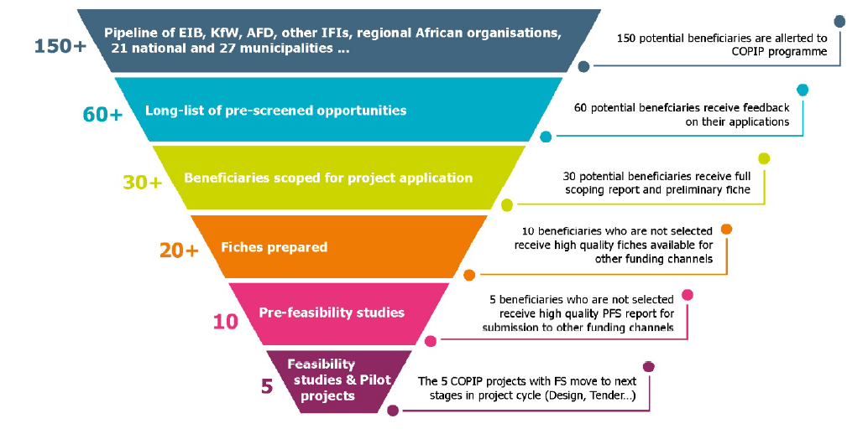
What we will do
Pipeline of EIB, KfW, AFD, other IFIs, regional African organisations
national, municipalities and private sector prospects
Notes:
Shows the process that we will follow. Filtering

Slide 8
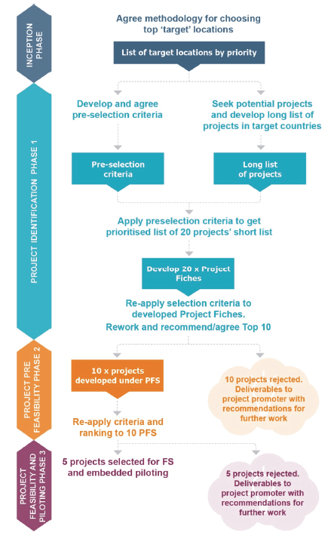
What we will do
Notes:
Process methodology for accepting the projects.

Slide 9
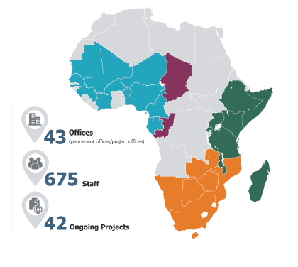
Who we are
Notes:
Tetra Tech and Egis have lengthy and extensive Sub-Saharan African experience in infrastructure services, from preparation to design and delivery, having delivered some 395 projects in the water resources, water supply Solid Waste, Wastewater and Storm Water sectors on the sub-continent in the past, of which 42 are still ongoing.
Tetra Tech’s footprint is primarily in Anglophone Africa, whilst Egis complements this, and adds a strong footprint in Francophone Africa.

Slide 10
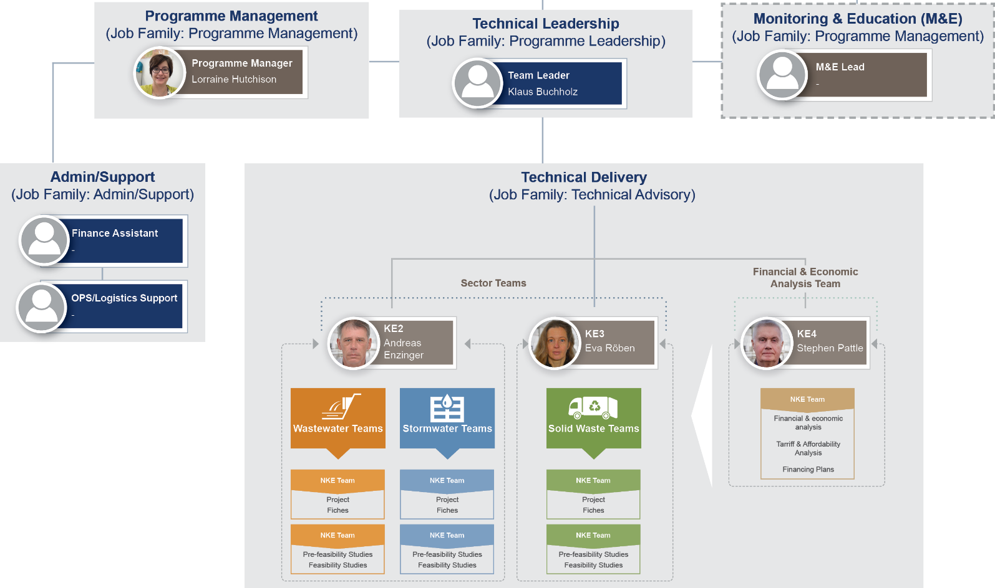
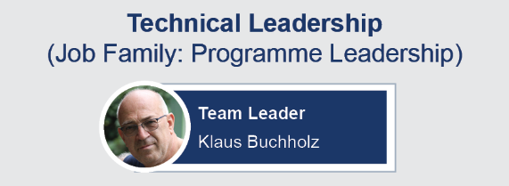
Who we are
Notes:
Below the Key experts are the cross cutting teams including institutional, environmental, social, M&E etc.
The project resourcing will be demand driven, using our technical expert pool for long term and short term assignments in the various countries as the project develops.

